Slide 1

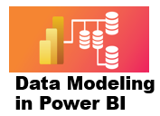



4 Introduction to DAX
Prepared By :
Said Fawzy
Manager of Information Center
Tendering Department
Arab Contractors

Slide 2
4 Introduction to DAX
Prepared By :
Said Fawzy
Manager of Information Center
Tendering Department
Arab Contractors

Slide 3

1
What is DAX?
2
Row context and filter context
3
Creating Calculated Columns
4
Exercise 6: Creating Calculated Columns

Slide 4
5
Exercise 7: Filtering Context
6
Introduction to calculated tables
7
Exercise 8: Adding a calculated table and column

Slide 5
1
What is DAX?

Slide 6


What is DAX ?
DAX
Power BI

Slide 7
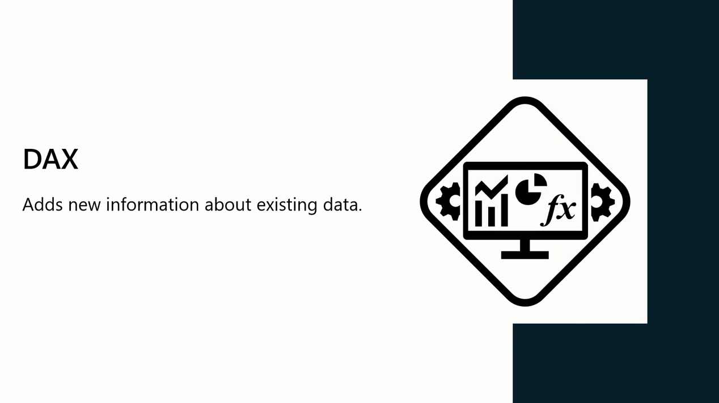
What is DAX ?
Data Analysis Expression

Slide 8
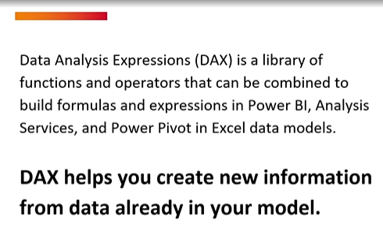
What is DAX ?

Slide 9
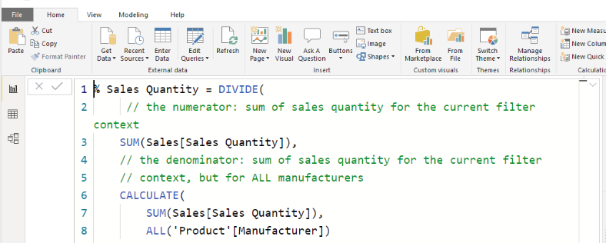
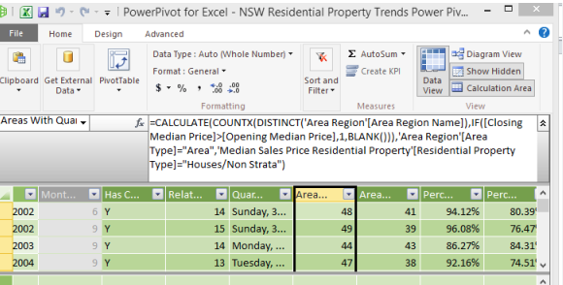
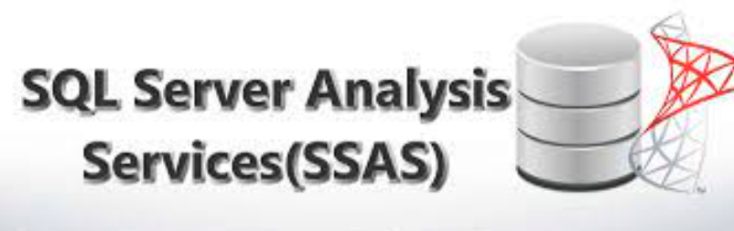
What is DAX ?
DAX is a programming language used in:
Microsoft SQL Server Analysis Services,
Power Pivot in Excel, and
Power BI.

Slide 10
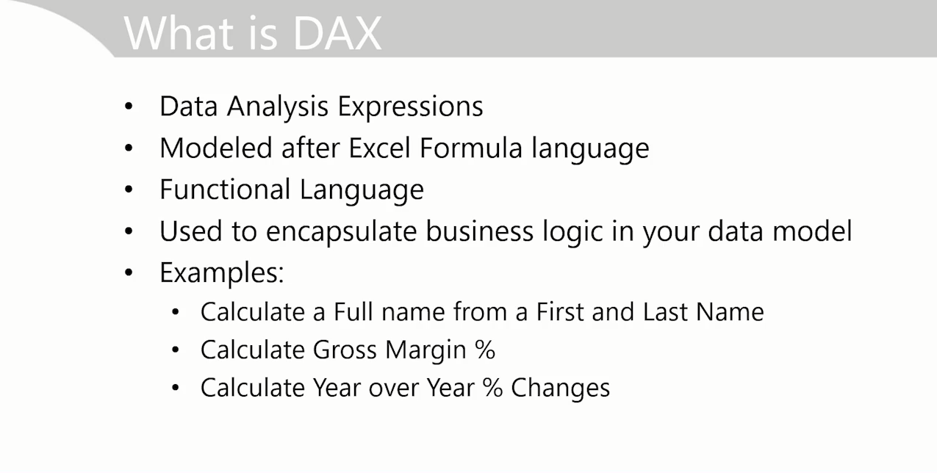
What is DAX ?

Slide 11
What is DAX ?
It is a library of:
functions,
operators, and
constants
Used in formulas or expressions to create additional information about the data are not present in the original data model.
With DAX expressions, you can create custom calculations on data models to extract maximum information from your data to solve real-world problems.

Slide 12
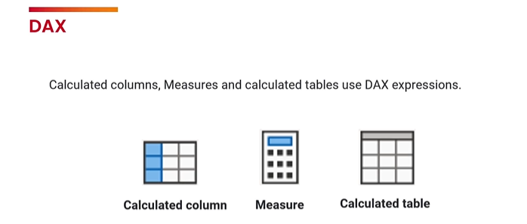
How Dax Can Help You?

Slide 13
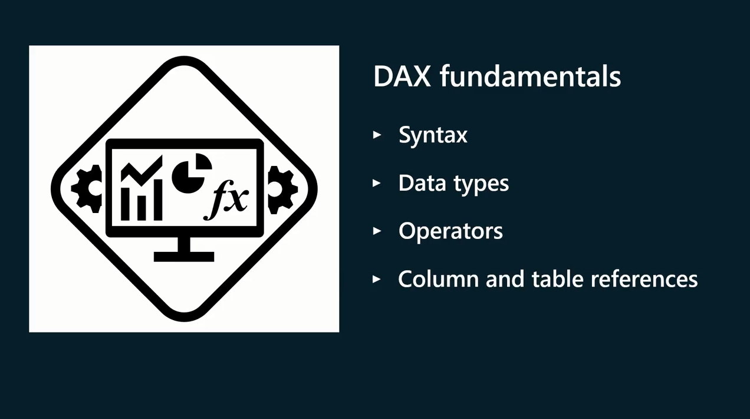

Slide 14
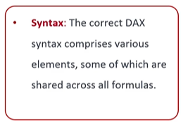
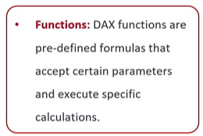
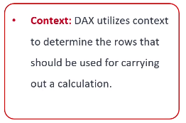
DAX Components

Slide 15
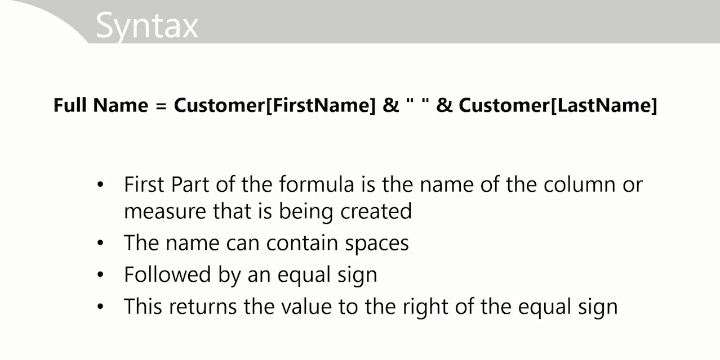
Syntax

Slide 16
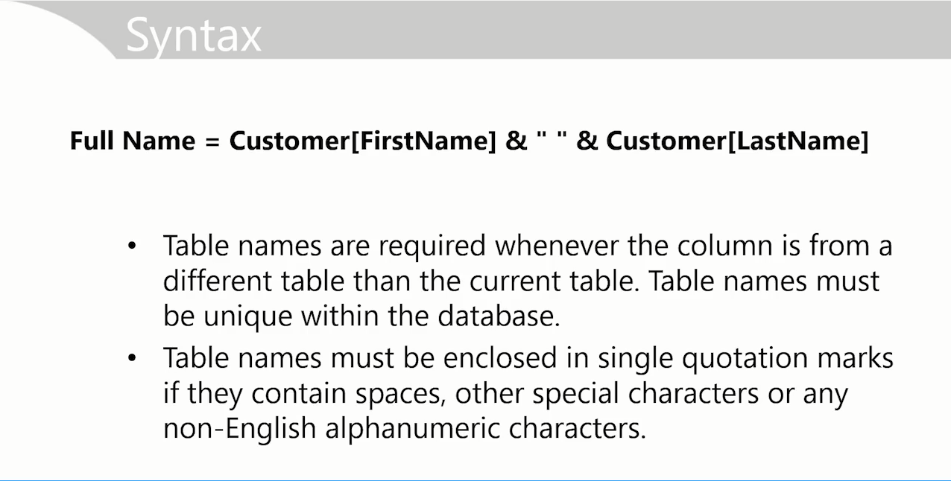
Syntax

Slide 17
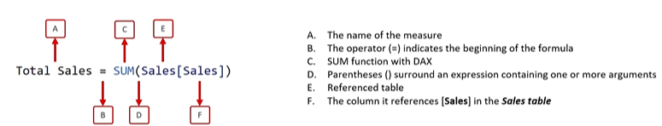
Syntax

Slide 18
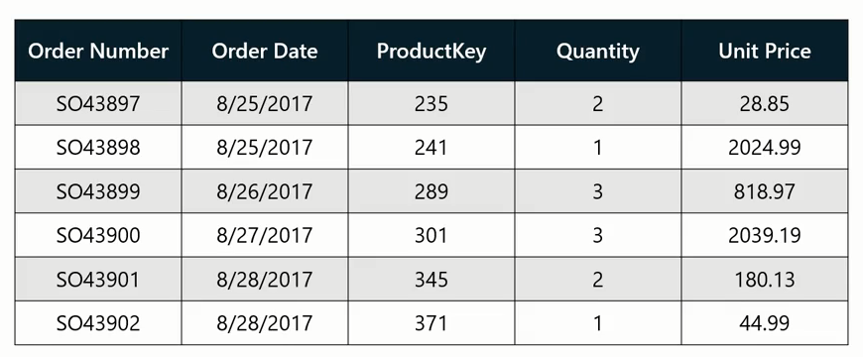
Example
Company needs total Quantity Sold

Slide 19
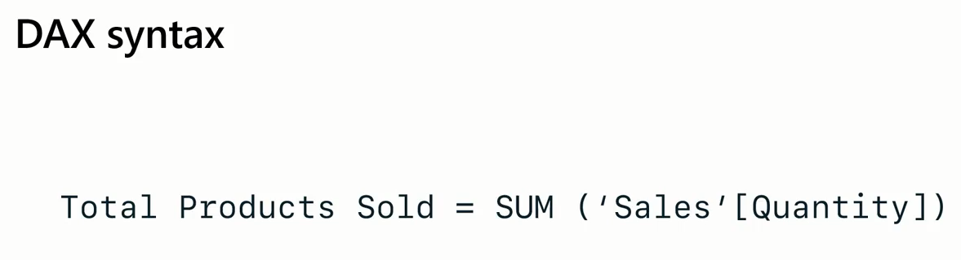
New Calculated Colum
DAX
Aggregation Function
Table Name
Column Name

Slide 20
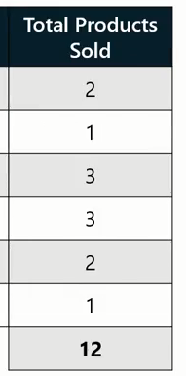
Example

Slide 21
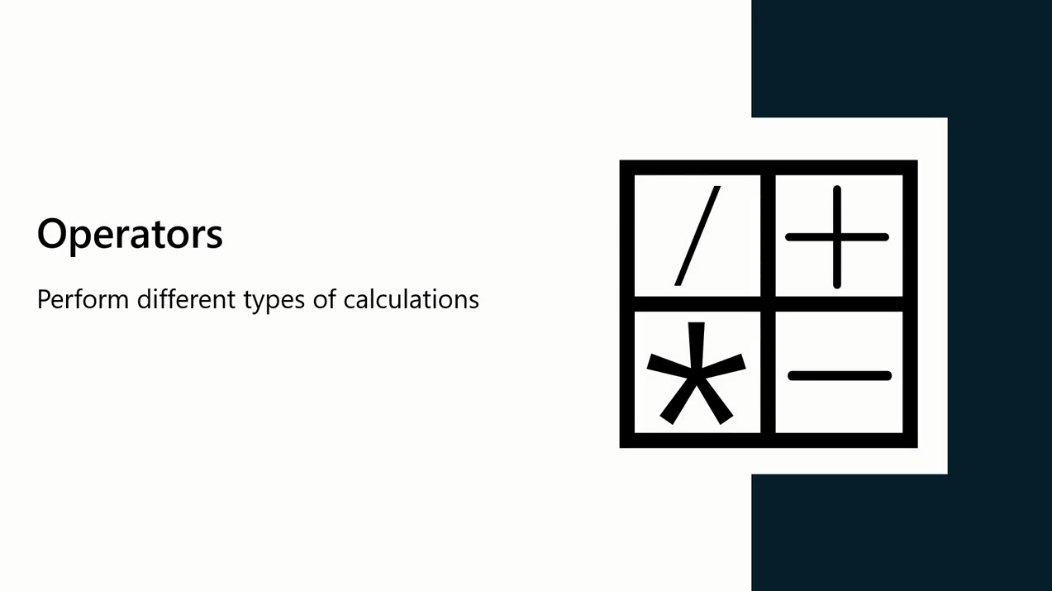
Operators

Slide 22
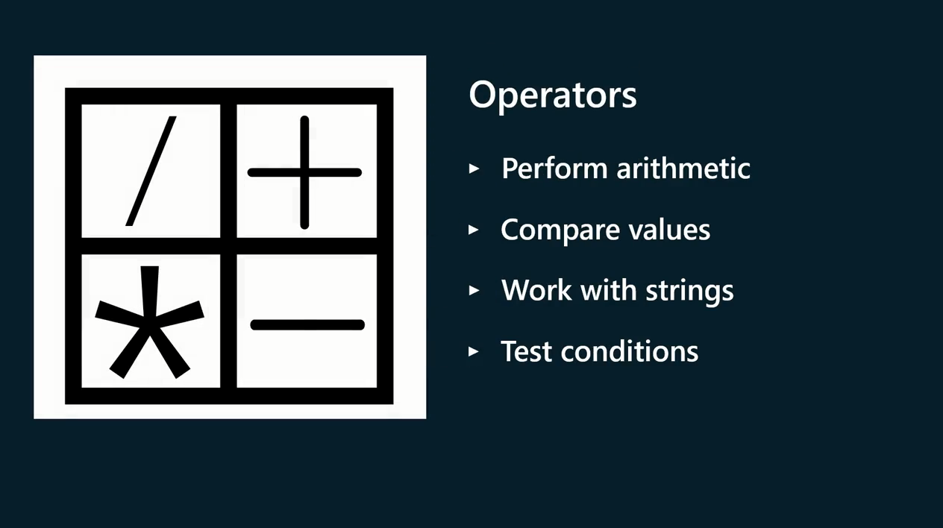

Slide 23

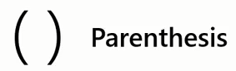


DAX Operators
Arithmetic Operators

Slide 24


DAX Operators

Slide 25
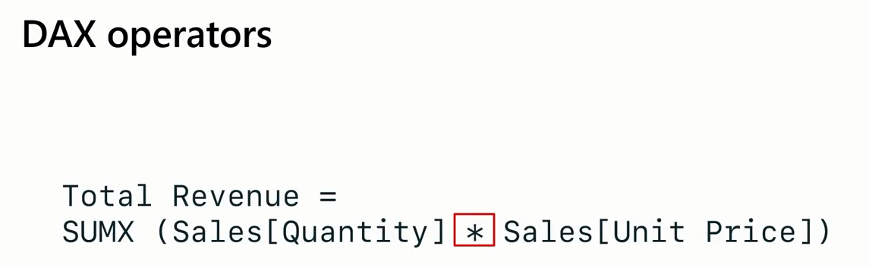
DAX Operators

Slide 26
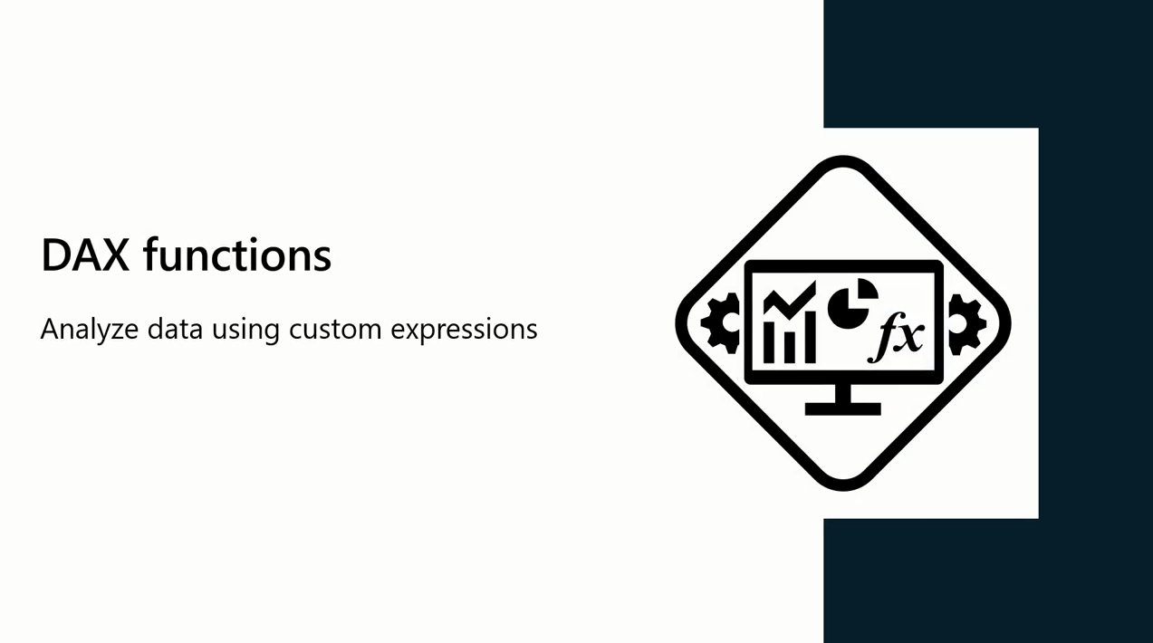
DAX Functions

Slide 27
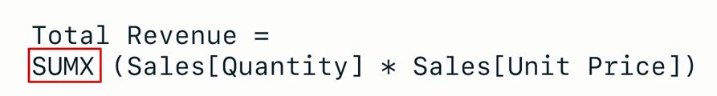
DAX Functions

Slide 28
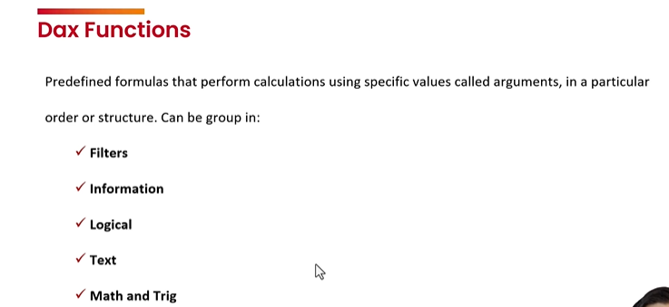
DAX Functions

Slide 29
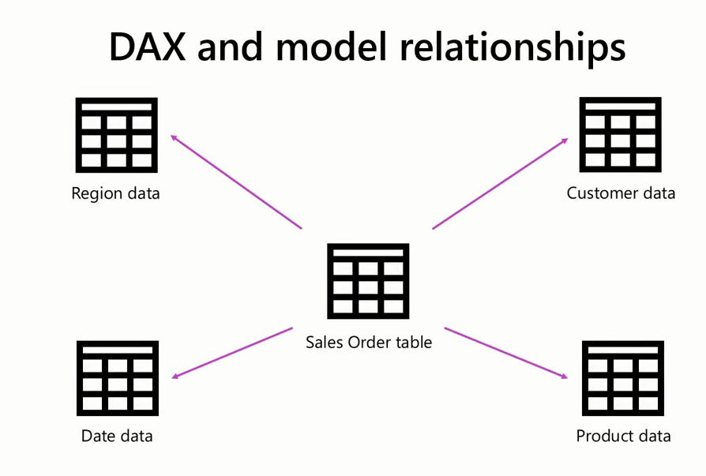
DAX and Model Relationship
Understanding how the tables relate to one another in your data model is crucial for creating meaningful calculations.

Slide 30
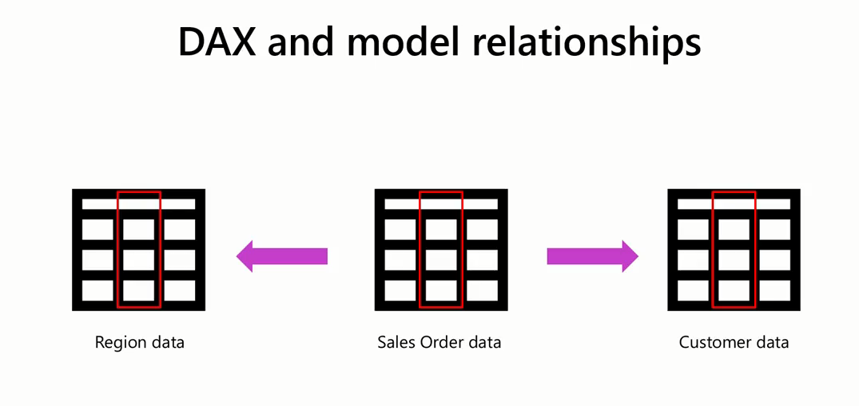
DAX and Model Relationship
Columns used to build the relationship are the keys of the relationship.
The column on one side of the relationship needs to have unique values

Slide 31
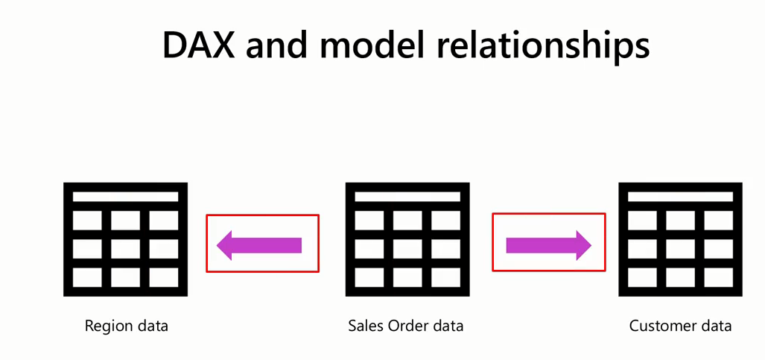
Tables relationships can be either single or bidirectional, the direction of the relationship determines the direction of automatic filtering

Slide 32
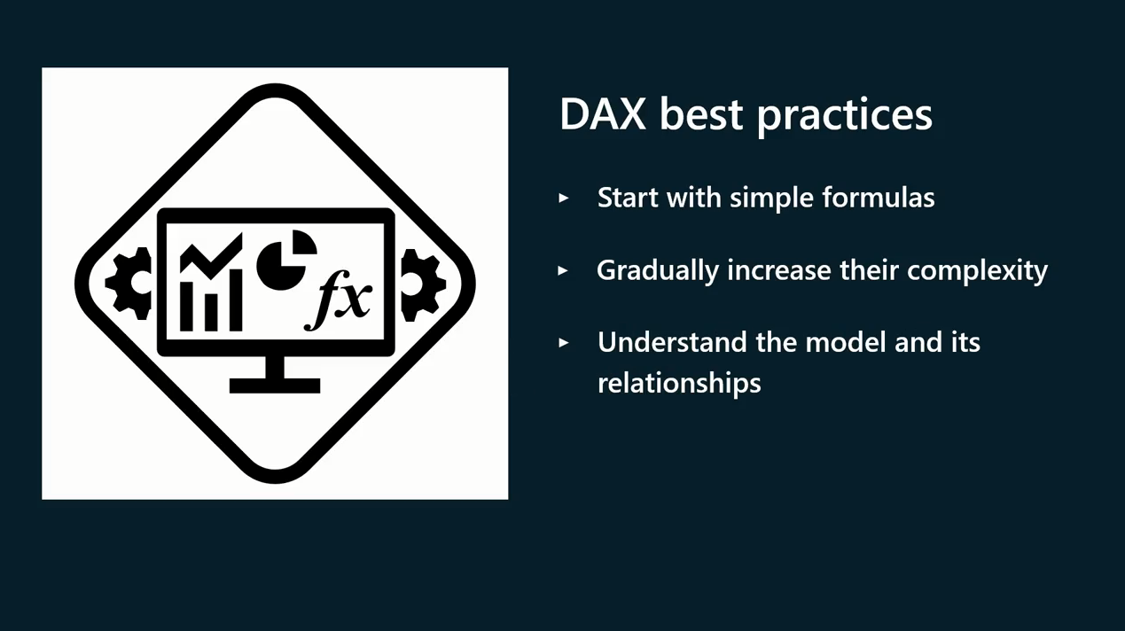

Slide 33
Question
Identify the components of a data analysis expression. Select all that apply.
Column and table references
Data types
Syntax
Operators

Slide 34
ANSWER
Identify the components of a data analysis expression. Select all that apply.
Column and table references
Data types
Syntax
Operators
A
B
C
D

Slide 35
2
Row context and filter context

Slide 36
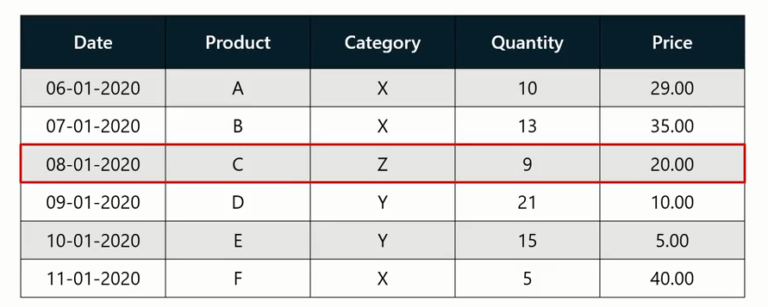
Row Context and Filter Context
What is the total Sales for each Product?
What is the Top Selling Items By Category?

Slide 37
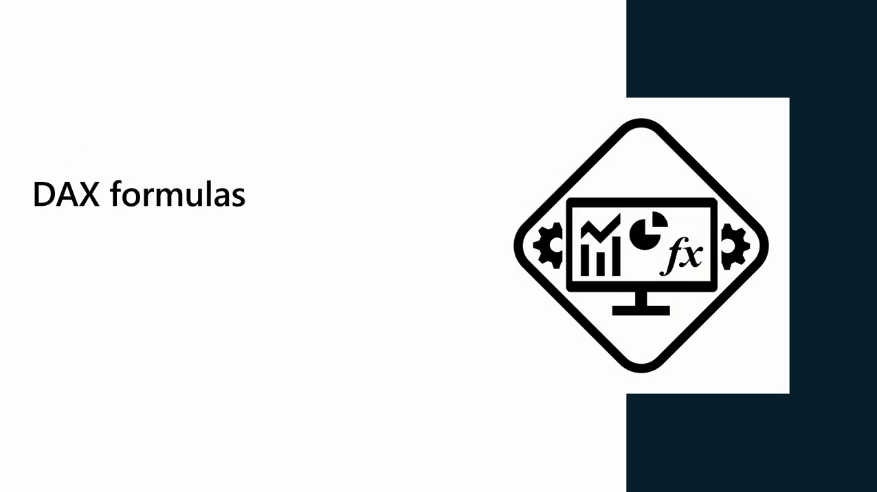
DAX Formulas
DAX computes formulas within a context

Slide 38

DAX Formulas
Row context refers to the tables current row being evaluated within a calculation

Slide 39
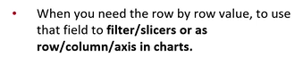
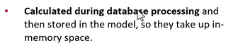
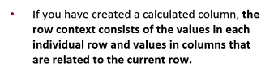
DAX Context

Slide 40
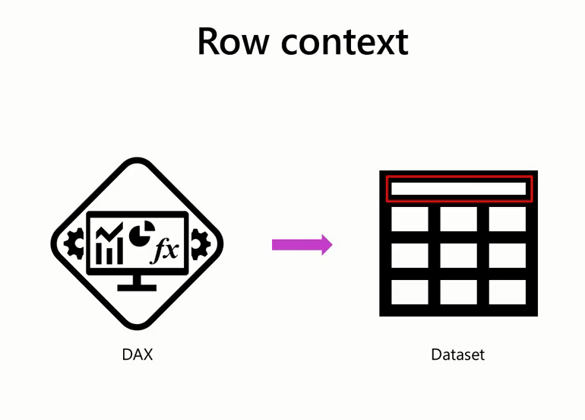
Row Context

Slide 41
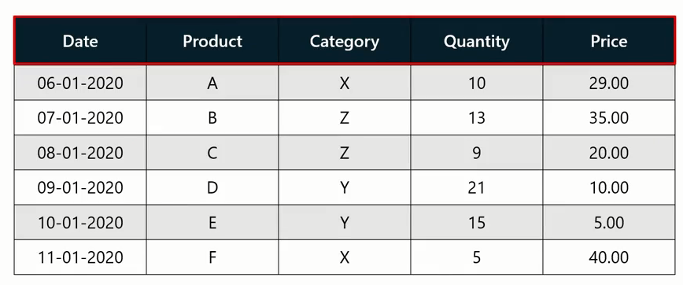
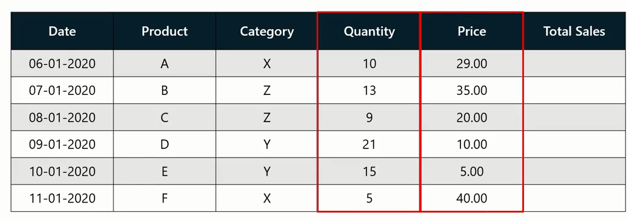
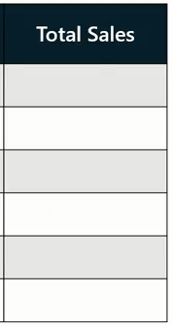
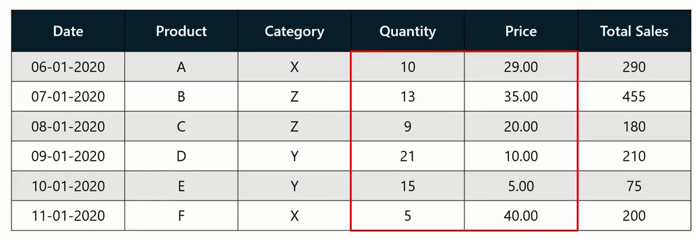
Row Context
What is the total Sales for each Product?

Slide 42

Filter Context

Slide 43
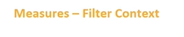
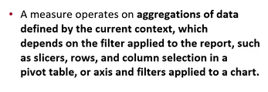
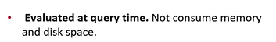
Filter Context

Slide 44
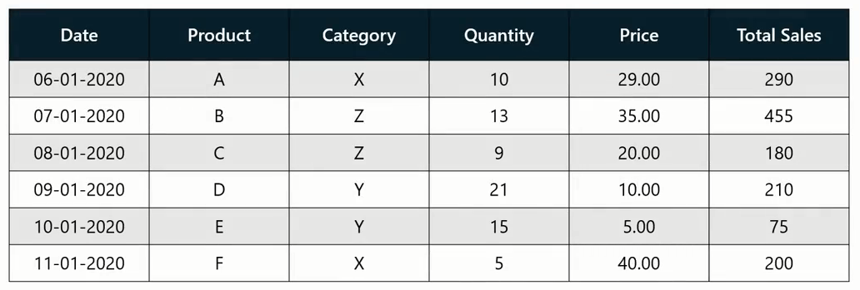
Row Context
In the previous example, a different result was produced in each cell because the same DAX expression was evaluated against different subsets of data

Slide 45
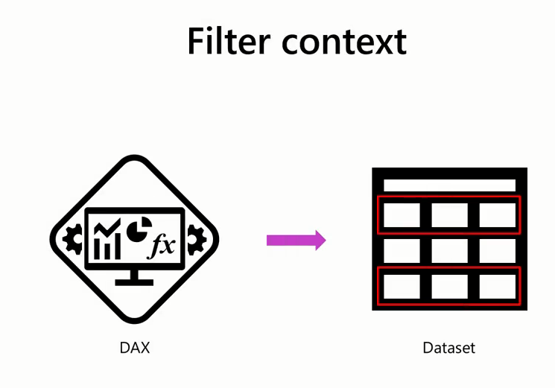
Filter Context

Slide 46
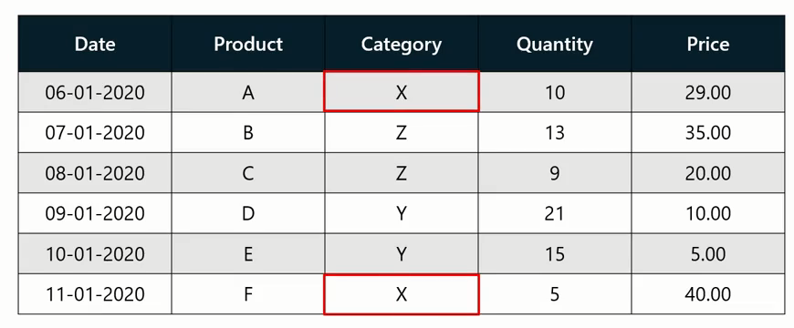
Filter Context
calculate the total sales for all items in Category X

Slide 47
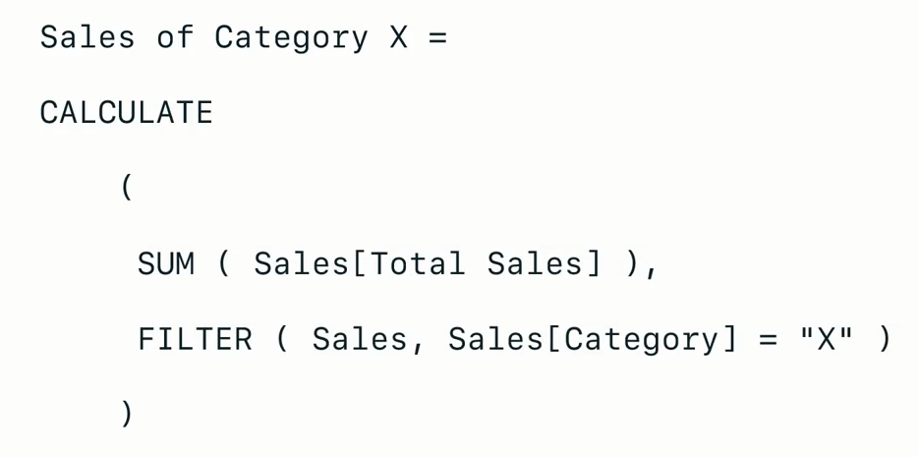
Filter Context

Slide 48
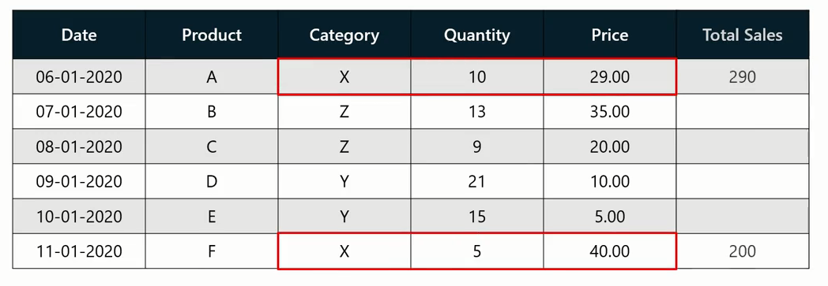
Filter Context

Slide 49
Filter Context
Filter ➔ Calculate
1
2

Slide 50
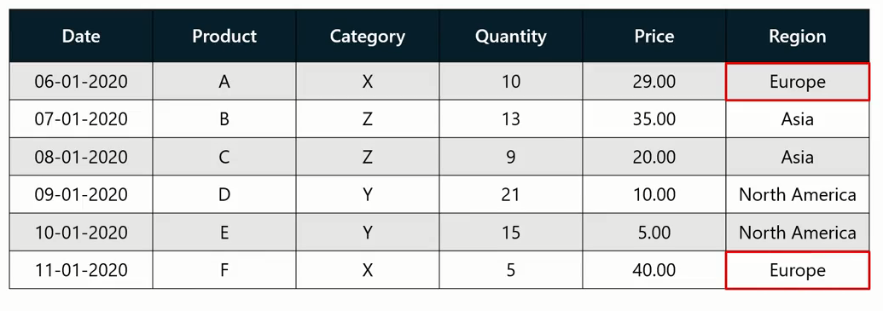
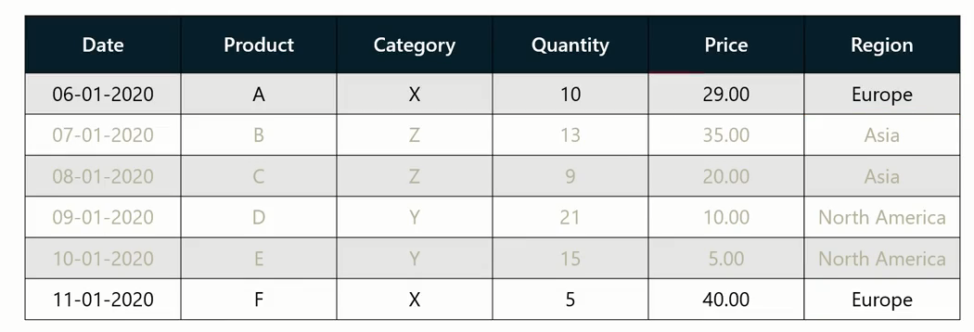
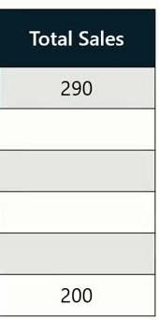

Filter Context
1
Filter
2
Calculate

Slide 51


Applying Multiple Filters

Slide 52


Filter then Calculate
Filter
Calculate

Slide 53


Propagation Filter
when data is filtered in the sales order table, then data in the related tables is also filtered.

Slide 54
Question
True or False: Filter context can only be applied to a calculation via writing a DAX expression.
True
False

Slide 55
Question
True or False: Filter context can only be applied to a calculation via writing a DAX expression.
True
False

Slide 56
3
Creating calculated columns

Slide 57


Example

Slide 58

What is Calculated Column?

Slide 59

Calculated Column

Slide 60

Traditional and Calculated Columns
Traditional columns are filled with data imported from a data source.
A calculated column is created by defining a DAX expression

Slide 61


Creating a Calculated Column

Slide 62


Creating a Calculated Column

Slide 63

Exercise 6:
Creating Calculated Columns

Slide 64
Scenario
Your company wants to calculate its profit margin from its Sales data in its Sales table by creating calculated columns.
However, the table is missing this data
You need to add it using DAX and Calculated Columns

Slide 65
Steps:
Step 1: Create Total Sales Column.
Step 2: Create Profit Column.
Step 3:Create Profit Margin Column
Step 4: Format Columns

Slide 66
Question 1
Exercise Questions
In Microsoft Power BI, what is the function of a calculated column?
A. It visualizes data in various formats such as charts and graphs.
B. It performs calculations on data using a DAX formula.
C. It sorts and filters data based on user-defined criteria.

Slide 67
ANSWER 1
Exercise Questions
In Microsoft Power BI, what is the function of a calculated column?
A. It visualizes data in various formats such as charts and graphs.
B. It performs calculations on data using a DAX formula.
C. It sorts and filters data based on user-defined criteria.

Slide 68

Calculated Column Review

Slide 69
Exercise 7:
Filtering Context

Slide 70
Scenario
We want to review some of the filtering context like:
Filters on All Pages.
Filters on this Page.
Filters on a Visual.

Slide 71
Steps:
Step 1: Review the Data Model.
Step 2: Review the Calculated field.
Step 3: Create 3 tables in Report View.
Step 4: Filters on All Pages.
Step 5: Filters on This Page.
Step 6: Filters on a Visual.

Slide 72
6
Introduction to calculated tables

Slide 73

Calculated Tables

Slide 74

Cloning a Tables

Slide 75

Cloning a Tables

Slide 76


Cloning a Tables

Slide 77

Calculated Tables
Combine data from different Data sources

Slide 78

Calculated Tables
Normalize Dimensional Table

Slide 79
Real-World applications of calculated table
By creating a calculated table for profitability analysis, you can draw insights into gross margins, net profits, and profit margins.
This helps organizations identify their most profitable products, categories, services, and customer segments
Profitability Analysis

Slide 80
Real-World applications of calculated table
Understanding customer behavior is crucial for marketing efforts.
You can create a calculated table with DAX to facilitate customer segmentation based on transaction history.
This helps businesses to tailor their marketing strategies for each customer segment.
Customer Segmentation

Slide 81
Real-World applications of calculated table
By creating a calculated table for profitability analysis, you can draw insights into gross margins, net profits, and profit margins.
This helps organizations identify their most profitable products, categories, services, and customer segments
Profitability Analysis

Slide 82
Real-World applications of calculated table
A date table is one of the most common tables that can be created using various methods in Power BI.
One method of creating a date table is using the DAX function CALENDER.
For example, a company can record several date columns in their dataset, like order date or shipping date.
The calculated table can then analyze the data using time intelligence built-in DAX functions like TOTALYTD, year-to-date, month-to-date, and so on.
Time Intelligence Analysis

Slide 83
Real-World applications of calculated table
By defining a calculated table in DAX for budget allocation and integrating it with historical data, you can perform variance analysis and make data-driven forecasts for future periods.
Budgeting and Forecasting

Slide 84
Question
Which of the following statements regarding calculated tables in Power BI and DAX are true? Select all that apply.
Calculated tables can only be created from a single data source.
Calculated tables are created within Power BI using DAX expressions.
Calculated tables combine data from different sources to facilitate deeper data analysis.
Changes to the original data source will always be reflected in the cloned calculated tables.

Slide 85
ANSWER
Which of the following statements regarding calculated tables in Power BI and DAX are true? Select all that apply.
Calculated tables can only be created from a single data source.
Calculated tables are created within Power BI using DAX expressions.
Calculated tables combine data from different sources to facilitate deeper data analysis.
Changes to the original data source will always be reflected in the cloned calculated tables.

Slide 86
Exercise 8:
Adding a
calculated table
and column

Slide 87
Scenario
Your company needs your help to analyze its sales data to generate insights into its sales performance. However, you must analyze the company’s data without altering the original dataset. You must also create summary tables and normalize dimension tables for analysis.
The company provides you with an Excel workbook called AdventureWorksData8.xlsx. You must load it to Power BI to complete your assigned task.
Be sure to evaluate the data quality and configure the model to ensure that Adventure Works can use it to make informed decisions.

Slide 88
Steps:
Step 1: Connect to the Adventure Works Dataset.
Step 2: Remove all duplicate values and set the relationships .
Step 3: Create a calculated table.
Step 4: Create calculated columns.
Step 5: Step 5: Clone Sales Table.
Step 6: Step 6:Create Annual Sales Summary Table.

Slide 89


Slide 90

Question 1
You are a data analyst working with a large sales dataset for an e-commerce company. You are employing Power BI as an analytical tool. In which of the following scenarios would it be beneficial to use DAX functions? Select all that apply.
Calculating the average sales per region.
Filtering the data to display only this year's sales.
Creating a column that flags high-value customers.
Importing a new sales dataset.

Slide 91
ANSWER 1
You are a data analyst working with a large sales dataset for an e-commerce company. You are employing Power BI as an analytical tool. In which of the following scenarios would it be beneficial to use DAX functions? Select all that apply.
Calculating the average sales per region.
Filtering the data to display only this year's sales.
Creating a column that flags high-value customers.
Importing a new sales dataset.

Slide 92
Question 2
True or False: You can create a calculated table in DAX to generate a table based on the defined expression.
A. True
B. False

Slide 93
ANSWER 2
True or False: You can create a calculated table in DAX to generate a table based on the defined expression.
A. True
B. False

Slide 94
Question 3
What is the purpose of the RELATED function in DAX?
A. To retrieve data from a related table.
B. To filter data based on specific criteria.
C. To establish relationships between tables.

Slide 95
ANSWER 3
What is the purpose of the RELATED function in DAX?
A. To retrieve data from a related table.
B. To filter data based on specific criteria.
C. To establish relationships between tables.

Slide 96
Question 4
Why should you clone a table in Power BI for use as a calculated table?
A. To keep a backup of your original dataset.
B. To reduce the size of your data model.
C. To perform calculations that are not possible on the original dataset.

Slide 97
ANSWER 4
Why should you clone a table in Power BI for use as a calculated table?
A. To keep a backup of your original dataset.
B. To reduce the size of your data model.
C. To perform calculations that are not possible on the original dataset.

Slide 98
Question 5
Regarding DAX, what does the term "evaluation context" refer to?
A. The set of filters and context that influence DAX calculations.
B. The visualization and charts created by DAX formulas.
C. The connection between Power BI and external data sources.

Slide 99
ANSWER 5
Regarding DAX, what does the term "evaluation context" refer to?
A. The set of filters and context that influence DAX calculations.
B. The visualization and charts created by DAX formulas.
C. The connection between Power BI and external data sources.

Slide 100


